Slide 1
Secure Data Hiding in Image Using Steganography
CAPSTONE PROJECT
Presented By: GANESH DHAKALI
Student Name : GANESH DHAKALI
College Name : VEMANA INSTITUTE OF TECHNOLOGY
Department : Computer Science and Engineering

Slide 2
OUTLINE
Problem Statement
Technology used
Wow factor
End users
Result
Conclusion
Git-hub Link
Future scope

Slide 3
Problem Statement
With the rise of cyber espionage and digital surveillance, traditional encryption attracts attention from attackers.
Steganography offers a covert way to communicate sensitive data by embedding it within digital media.
However, challenges remain:
Capacity: Embedding more data without compromising image quality.
Robustness: Resistance to compression, noise, and image processing attacks.
Security: Risk of detection by steganalysis techniques.

Slide 4
Technology used
Programming Language : Python
Libraries Used : OpenCV, NumPy, Pillow (PIL), Matplotlib
Steganographic Algorithm: Least Significant Bit (LSB) Technique
Platform : Windows/Linux
Development Tools : Jupyter Notebook, PyCharm, VS Code

Slide 5
Algorithm & Implementation
Embedding: Encrypt data → Embed in LSB → Store stego image.
Extraction: Read stego image → Extract LSB → Decrypt.
Security: Key-based access prevents unauthorized retrieval.

Slide 6
Wow factors
Invisible to the Naked Eye: The hidden data remains undetectable unless decoded using the correct method.
Minimal Image Distortion: The original image appears unchanged, maintaining its quality.
Secure Encoding & Decoding: Uses password-based retrieval to enhance security.
Efficient & Lightweight: Low computational cost makes it ideal for real-time applications.
Multiple Format Support: Can hide data in PNG, BMP, and JPEG formats.

Slide 7
End users
Government Agencies: Secure transmission of classified information.
Journalists & Whistleblowers: Safe communication without detection.
Corporate Sector: Confidential document sharing.
Cybersecurity Enthusiasts & Researchers: Exploring hidden communication methods.

Slide 8


Results
Real Image Encrypted Image

Slide 9
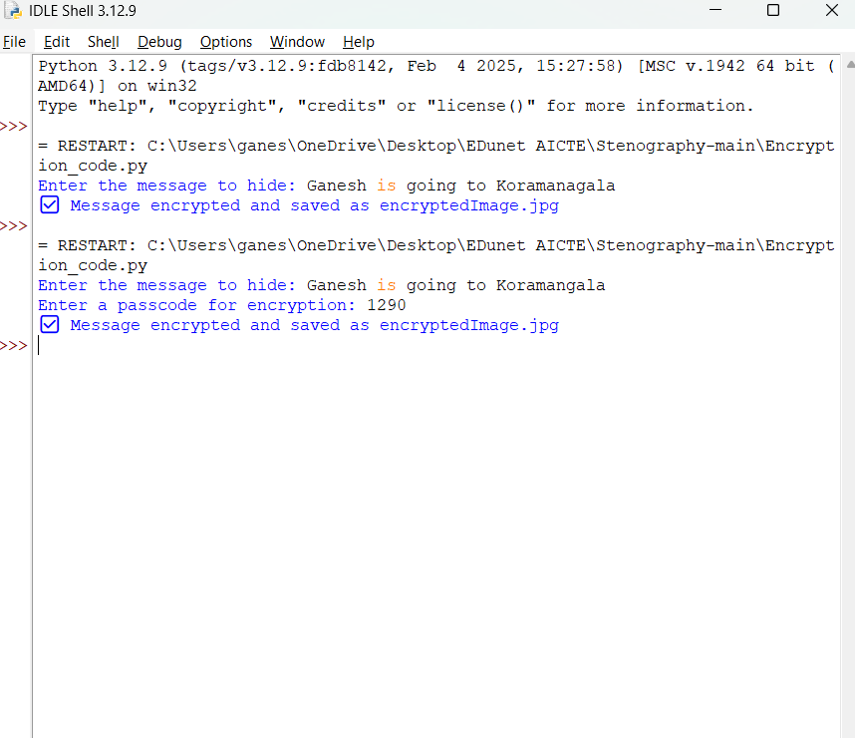
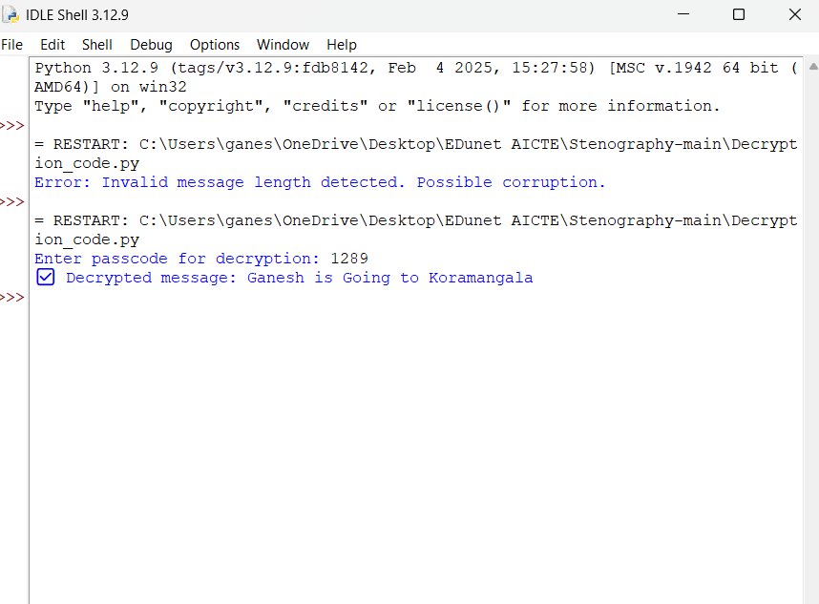
Encrypted Message
Decrypted Message

Slide 10
Conclusion
Steganography is a powerful technique for secure data hiding in digital images.
The implemented LSB technique provides an efficient and lightweight method for concealing sensitive information.
This approach ensures confidentiality while maintaining the original image’s quality.
Future improvements can focus on enhancing security by integrating encryption with steganography.

Slide 11
GitHub Link
https://github.com/GaneshDhakali/AICTE---Project-Edunet-

Slide 12
Future scope(optional)
AI-Based Detection Resistance: Implement deep learning models to avoid detection from steganalysis tools.
Encryption Integration: Adding AES or RSA encryption before embedding data.
Audio & Video Steganography: Expanding the technique to other media formats.
Cloud-Based Secure Sharing: A web-based system for encrypted steganographic file sharing.

Slide 13
THANK YOU

